Slide 1
Socially Responsible Corporate Customers
Rui Dai
Wharton School of Business
Hao Liang
Lee Kong Chian School of Business
Lilian Ng
Schulich School of Business
Presented by Austin Francis

Slide 2
Research Question
How do corporate customers drive CSR practices in global supply chains, and what are the economic implications for both customers and suppliers?

Slide 3
Prior Literature
Limited Research on Customer Influence: Few studies have examined the specific role of corporate customers in driving CSR practices among suppliers (Kitzmueller & Shimshack, 2012; Koehn & Ueng, 2010).
CSR Motivations and Agency Problems: Existing literature primarily attributes CSR engagement to a firm's strategic pursuit of financial performance and addresses agency problems within corporations (Flammer, 2015a; Masulis & Reza, 2015; Cheng et al., 2016).
Institutional and Environmental Factors: Recent research highlights the impact of national institutions and inter-firm interactions on CSR, but lacks focus on economically linked stakeholders like corporate customers (Ioannou & Serafeim, 2012; Liang & Renneboog, 2017).

Slide 4
Hypothesis
Corporate customers exert a significant unilateral influence on their suppliers’ CSR practices, resulting in improved CSR performance among suppliers that is economically beneficial for both parties.

Slide 5
Key Metrics
CSR(S) = CSR Supplier Score
CSR(C) = CSR Customer Score
Notes:
CSR = Corporate Social Responsibility

Slide 6
Results
Large corporate customers significantly drive improvements in suppliers’ CSR practices through their bargaining power and collaborative efforts.
A firm's CSR initiatives can create a multiplier effect across global supply chains, enhancing operational efficiency and firm value for both customers and suppliers.
Companies are incentivized to promote responsible practices among suppliers, especially in response to product-safety scandals, highlighting the importance of CSR in strategic management and organizational behavior.

Slide 7
Data Collection
Customer-supplier relationships from FactSet Revere
CSR ratings provided by Thomson Reuters ASSET4 ESG Database
M&A information from SDC Platinum

Slide 8
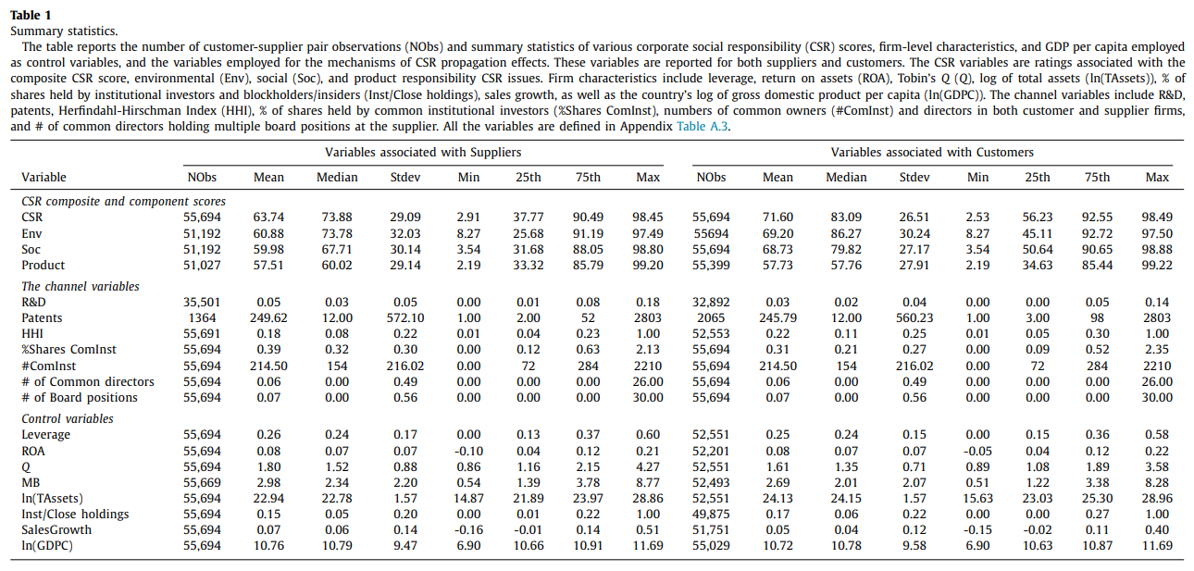
Notes:
Notice that Customers have a higher CSR Score. % hares held by common institutional Investors

Slide 9
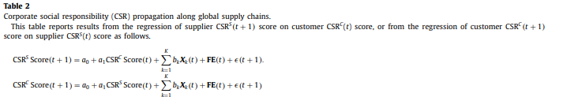
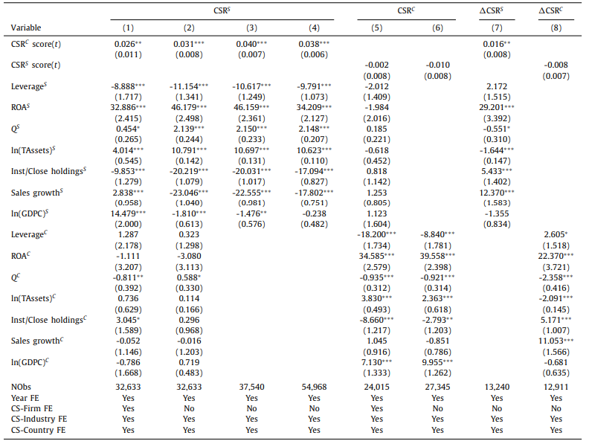
Notes:
Columns 1-4 Dependent variable is Supplier CSR Score and the key independent variable is Customer CSR Score (Column 4 all customer supplier relationships with less than 2 years) Columns 5-6 Dependent variable is Customer CSR Score and Key Variable is Supplier CSR Score Delta CSR is from T to T+2 You can see that the relationship is only one way.

Slide 10
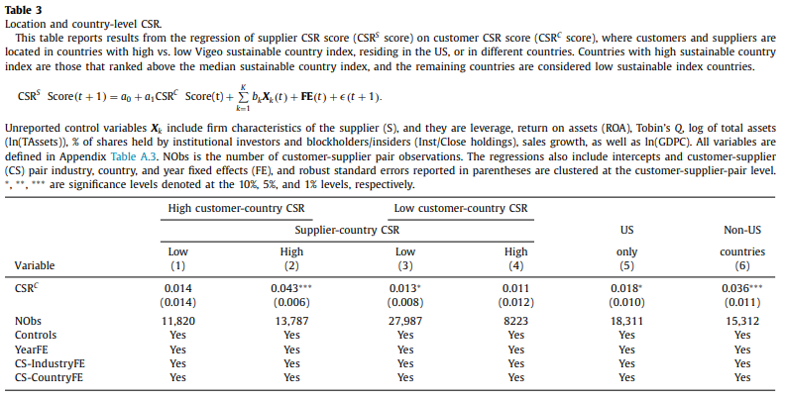
Notes:
WHEN THE CUSTOMER COUNTRY IS HIGH, it has a stronger influence only on high Supplier country Varying social political contexts make it difficult for a customer to pressure its supplier to act responsibly. We test this conjecture by replicating our baseline regression results shown in Column 4 of Table 2 on a sample of suppliers and customers located in countries with high vs. low national CSR standards
We employ the Vigeocountry index to rank the 50 countries in our sample. We classify the top 25 countries as those with high national CSR standards and the rest as those with low national CSR standards. Our analysis also includes tests on a sample of customers and suppliers residing in the US and on another located in non-US countries

Slide 11
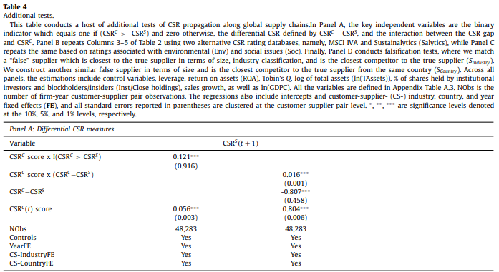
Notes:
Two additional Measures. CSR GAP. Measuring the difference Between CSRC and CSRS With an Indicator Variable and otherwise Meant to rule out the alternative interpretation of the baseline result that customers with weak CSR performance induce suppliers to become less socially responsible.
We construct two additional CSR measures that capture the differential CSR between customers and suppliers (CSR gap);
further confirm our baseline finding that customers play a significant role in suppliers striving for high CSR standards. For example, the overall customer effect of CSR on supplier CSR is 0.177 (=0.121+0.056) in Column 1 and is 0.820 (=0.016+0.804) in Column 2. All the coefficients are statistically significant at conventional levels.

Slide 12
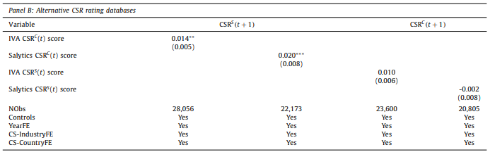
Notes:
Alternative measures of CSR

Slide 13
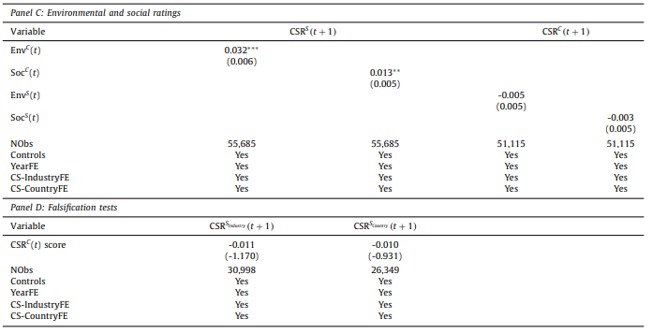
Notes:
Envirenmental and social Specific tests Using a pseudo supplier, similar in size and industry, and with no links, and effect is not there.

Slide 14
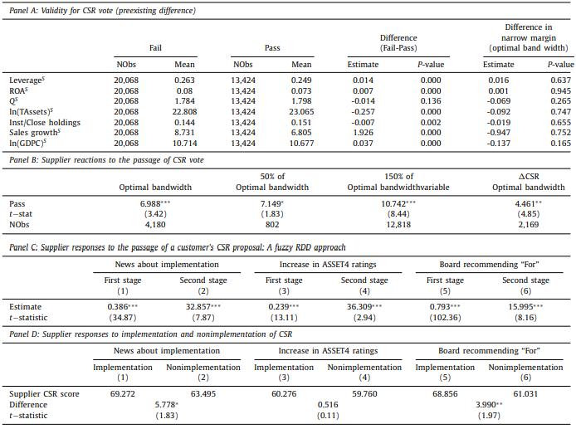
Notes:
The study has a sample of 31,634 customer CSR related shareholder-sponsored proposals that allows us to examine T+1 CSR scores of suppliers whose customers marginally pass a CSR Proposal (pass suppliers)
Panel A suggests no systemic or significant difference between pass and fail suppliers around the majority threshold, which lends support to our identification strategy.
Panel B shows RDD estimates of the difference in CSR performances between pass and fail suppliers, with different bandwidths. Panel D indicates greater and statistically significant CSR imporovements in the subsample of implemented than non implemented proposals for both news of CSR implementation and board voted “for” categories

Slide 15
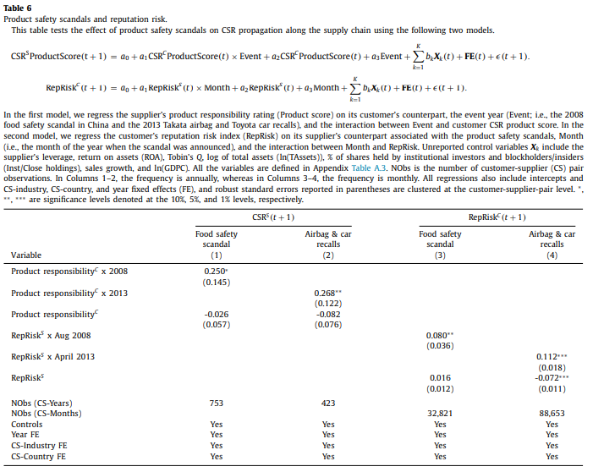
Notes:
Second Identification Strategy focuses on some of the worst product safety issues or scandals in history that have drawn global attention and heightened societal awareness and activism demanding for more socially responsible practices among supply chains 2008 Chinese milk scandal. Infant milk conatained Melamine and gave kids kidney stones. 300,000 Chinese babies were sick and the damage led to 6 deaths. 2013 Toyota defective airbags Column 1 shows estimates on a sample of existing inked firms in the global related food industry suppliers Variable of interest is the interaction between CSRC and event indicator. Coefficient is positive and statistically significant in both cases. A one standard deviation increases in customers product responsibility rating in the scandal year will lead to a 9 % to 10.9% rise in the suppliers mean product responsibility rating. These findings suggest that the effect of a customers product responsibility rating on the suppliers rating is more pronounced in the event year. Indicating that pressure is more intense. Results from columns 3-4 suggest strong evidence of a positive association between the suppliers REPRIsk and the customers next month RepRisk index. This transmission of reprisk from supplier to customer provides a strong incentive for the customer to strengthen it’s influence on its supplier’s CSR when a global ESG scandal floods the worldwide news media.

Slide 16
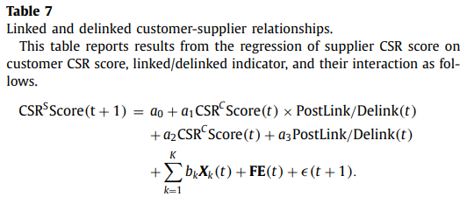
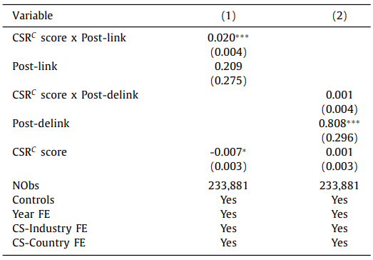
Notes:
Customers with high CSR may select suppliers who meet their expectations. It is also possible that customers actively push suppliers to get involved in CSR. Column 1 shows the overall customer CSR effect to be .013 on supplier CSR. Suggesting some selection associated with the initial establishment of the relationship. Socially conscious customers choose firms with igh CSR potential to form a supply chain relationship, and dissolve the relationship if the supplier is constrained to further improve its csr standards

Slide 17
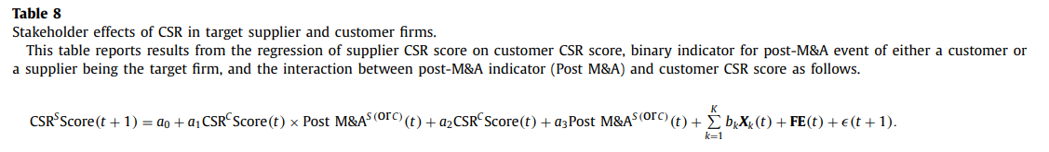
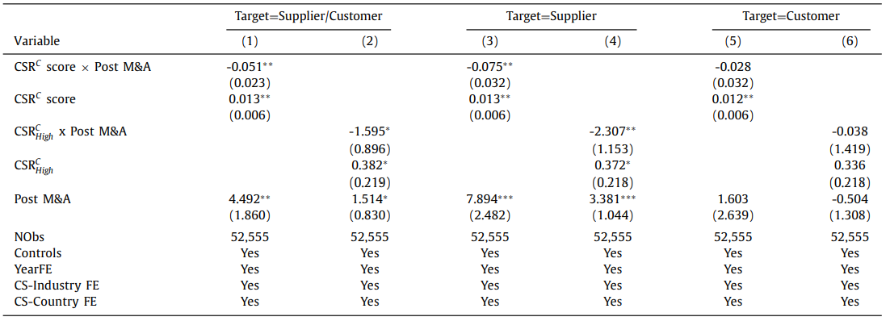
Notes:
In columns 1-2, the impact of all acquisitions on the suppliers subsequent CSR performance columns 3-4 and 5-6 show separate results of suppliers as targets and customers as targets, respectively. Columns 2, 4, 6 report the effect of customers whose CSR ratings are above the median level of the sample customer CSR rankings Columns 3 and 4, when a supplier is the target, its CSR practices become negatively associated with its customers. It may be that the suppliers acquirer is unwilling to expend more resources to maintain the sustainability of the suppliers CSR standard. When customer is the

Slide 18
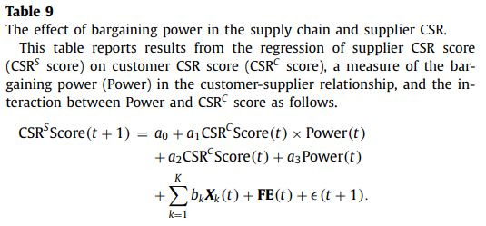
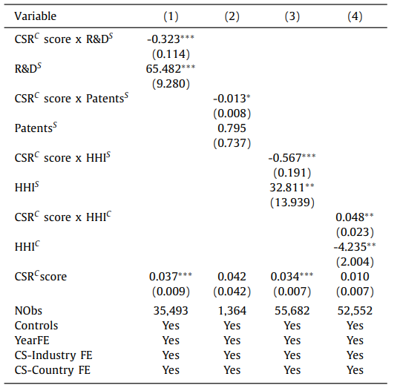
Notes:
Theory: suppliers with more investments in innovation are more likely to engage in customer specific investments. The greater the suppliers innovation capacity, the customers would have less power to influence their suppliers to be more socially responsible. In columns 1-2. They are consistent with expectations. The interaction effect of CSRC score and INNOV(S) is negative and statistically significant for both proxies of the customer specific investment For instance, the interaction effect of CSRC and R&D is -.323 this finding suggests that when a supplier’s customer specific investment is low, the supplier is more inclined to meet the CSR standard of its customer. In other words, if they have less bargaining power, they comply more.
Column 3-4 measures Industry competition. Column3 is suppliers HHI on suppliers CRS score. Column 4 is customers HHI Column 4 is When the supplier is in a highly competitive industry, it tends to align its practices with that of its customer. This suggests that the supplier may lose it’s customer if it doesn ot improve its CSR standard
On the other hand, when a customer is in a less competitive industry, it has strong bargaining power to influence its suppliers to be more socially responsible.

Slide 19
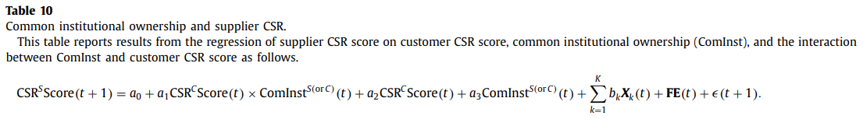
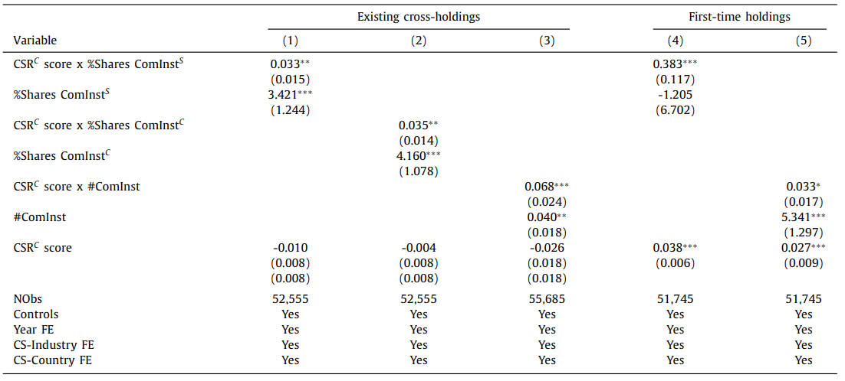
Notes:
Influence of Shared Ownership: Common institutional ownership between customer and supplier firms correlates positively with suppliers’ CSR (Corporate Social Responsibility) scores. This suggests that shared institutional investors are effective in transmitting CSR standards along the supply chain, as suppliers tend to adopt CSR practices that align with their customers' expectations​(Dai, Liang, Ng, 2020).
Multiplier Effect in CSR Standards: When a customer with high CSR standards shares institutional ownership with a supplier, there’s a notable “multiplier effect,” where a higher CSR rating of the customer encourages a more substantial increase in the supplier's CSR scores. This effect emphasizes the role of common investors in fostering CSR consistency across related firms​(Dai, Liang, Ng, 2020).
Strengthened CSR Through Networked Influence: The presence of common institutional investors not only improves CSR alignment between customers and suppliers but also demonstrates how networked ownership can drive responsible practices across sectors, indicating that institutional investors may prioritize firms that actively engage in CSR practices​

Slide 20
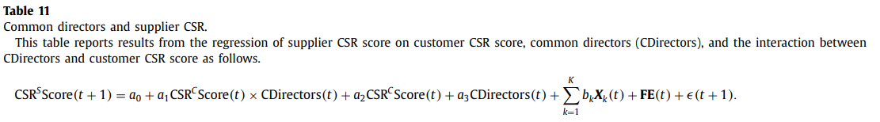
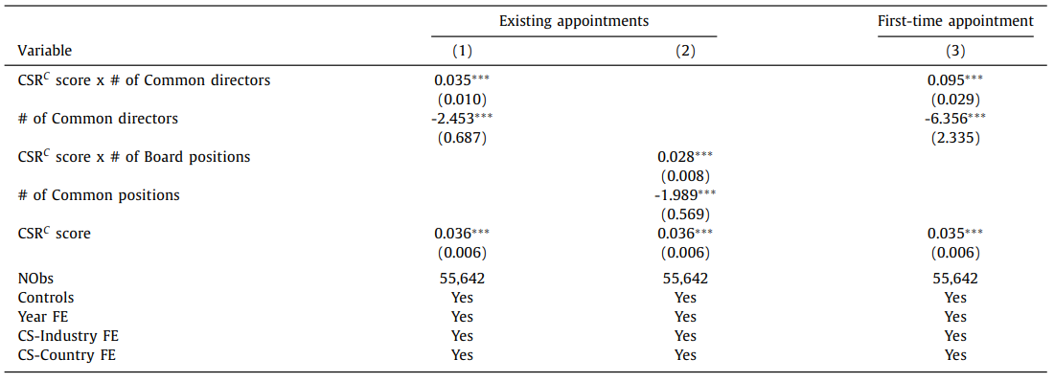
Notes:
Positive CSR Influence Through Board Overlap: Common directors between customer and supplier firms significantly influence CSR alignment, where suppliers tend to adopt stronger CSR standards when there is a board member overlap with customers. This finding highlights the impact of shared governance in driving CSR consistency within supply chains​ Importance of Newly Appointed Directors: The appointment of new directors who have affiliations with both customer and supplier firms boosts the likelihood of CSR improvement among suppliers. This suggests that recent governance linkages can actively enhance CSR practices, likely through shared values or increased CSR-related oversight​(Dai, Liang, Ng, 2020).
Extended Influence Beyond Direct Financial Ties: Even when there isn’t a direct financial relationship, overlapping directorships can still promote CSR practices among suppliers. This indicates that social networks and shared board values play a crucial role in propagating responsible business behaviors across connected firms​(Dai, Liang, Ng, 2020).

Slide 21
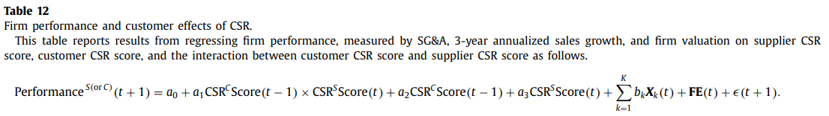
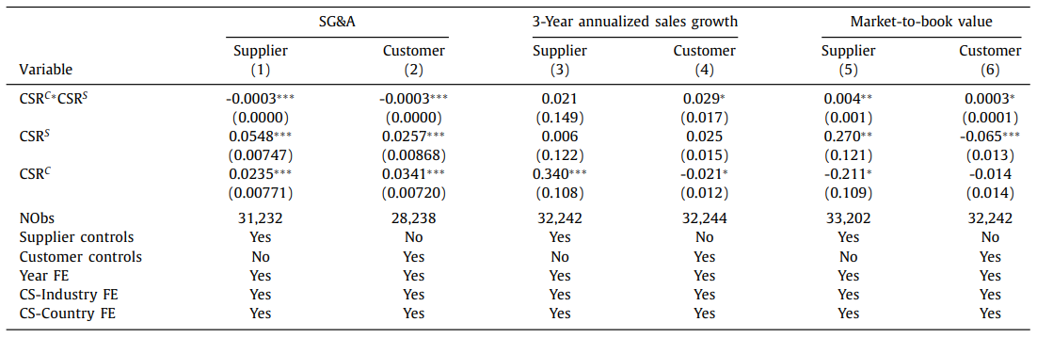
Notes:
Operational Efficiency Gains: Suppliers that align their CSR practices with those of their customers experience reductions in operational expenses, such as selling, general, and administrative (SG&A) costs. This efficiency improvement suggests that CSR alignment not only meets ethical standards but also drives cost-saving advantages​(Dai, Liang, Ng, 2020).
Customer Sales Growth: Customers who successfully encourage higher CSR standards from their suppliers enjoy increased sales growth, highlighting the market benefits of CSR alignment. The reputation boost from responsible supply chain practices likely contributes to this sales increase for customers​(Dai, Liang, Ng, 2020)​(Dai, Liang, Ng, 2020).
Enhanced Firm Valuation: Both customers and suppliers benefit in terms of market valuation when they engage in coordinated CSR efforts. However, customers, in particular, show a stronger valuation impact, which underlines the broader market appeal and financial incentives associated with CSR-driven supply chain management​(Dai, Liang, Ng, 2020).

Slide 22
Conclusion
Large corporate customers significantly drive improvements in suppliers’ CSR practices through their bargaining power and collaborative efforts.
A firm's CSR initiatives can create a multiplier effect across global supply chains, enhancing operational efficiency and firm value for both customers and suppliers.
Companies are incentivized to promote responsible practices among suppliers, especially in response to product-safety scandals, highlighting the importance of CSR in strategic management and organizational behavior.

